Slide 1
Evaluating the Quality of Assessment and Survey Items
Using (Interactive) Visualizations
Okan Bulut
Centre for Research in Applied Measurement and Evaluation
University of Alberta
To download this presentation: http://bit.ly/csse2019dataviz

Slide 2
Outline
01
Overview
Why data visualization?
02
Data visualization principles
What are the key principles in developing visualizations?
03
Evaluating items visually
What are the visual analysis options for evaluating survey items?

Slide 3
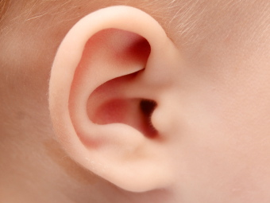


LEARNING STYLES
“Learning styles” suggest that each individual learns differently.
+Second
+First
+Third
VISUAL
TACTILE
AUDITORY

Slide 4
LEARNING STYLES
2
Go to www.menti.com
Use the code:
13 28 71
Please fill out the learning style inventory in the following link:
https://goo.gl/JY6Vjq
1

Slide 5
Why Visualization?

Slide 6
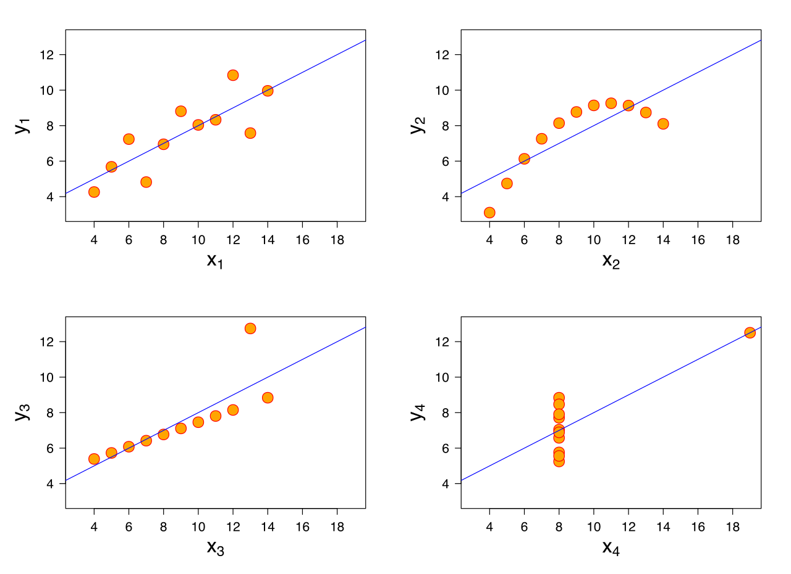
Four datasets with nearly identical simple descriptive statistics for x and y but they have very different distributions…
Property | Value
Mean of x | 9
Mean of y | 7.50
SD of x | 3.32
SD of y | 2.03
Correlation of x and y | 0.82
Source: https://en.wikipedia.org/wiki/Anscombe%27s_quartet

Slide 7
To move a huge amount of information into the brain very quickly
To identify patterns and communicate relationships and meaning
To inspire new questions and further exploration
To help identify sub-problems
To discover or search for interesting or specific data points in a larger field

Slide 8
Source: Hand drawn by William Playfair (1786) in The Commercial and Political Atlas – to make a case against England’s policy of financing colonial wars through national debt.

Slide 9
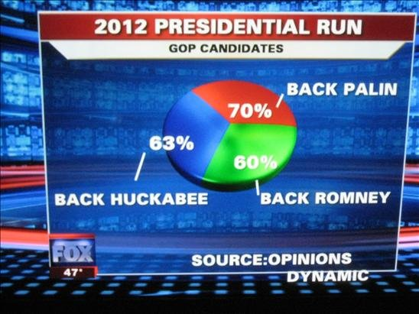
Did we get any better?
Source: Fox News – the percentages add up to 193%...

Slide 10
“The key function of data visualization is to move information from point A to point B.”
-- Iliinsky and Steele (2011)
A
B
A
B
DESIGNER
AUDIENCE

Slide 11
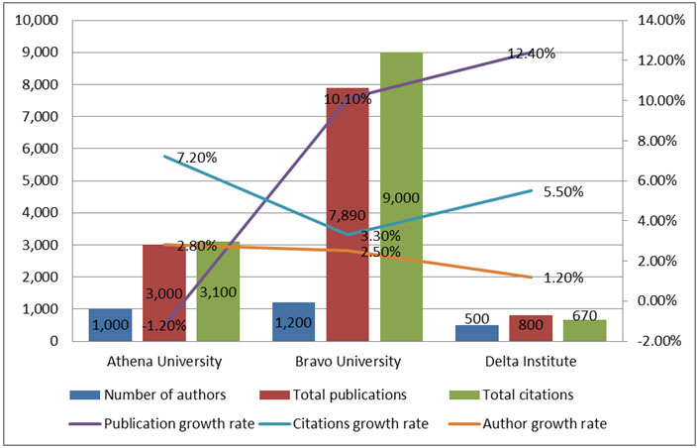

We have all done this…

Slide 12
Purpose

Slide 13
AUDIENCE
PERSUASIVE
INFORMATIVE
DESIGNER
VISUALIZATION
DATA
Source: Adapted from Iliinsky and Steele (2011, p. 9)

Slide 14

In practice, we…
EXPLORE (Informative)
Potential issues in the data:
Missingness
Outliers
Non-normality
Non-linearity
Extreme skewness and kurtosis
EXPLAIN (Informative)
Relationships between variables; correlations; interactions; patterns over time
PROVE (Persuasive)
Statistical models (e.g., regression); model fit; accuracy; predictions; inferences

Slide 15
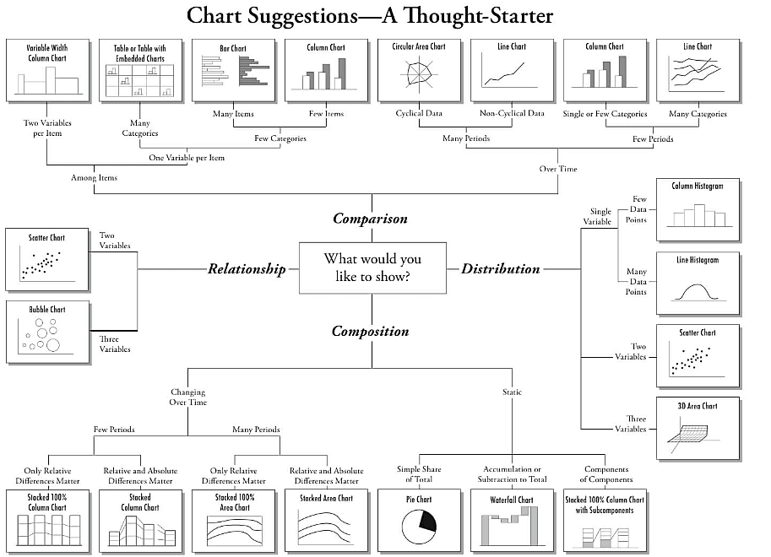
Source: https://extremepresentation.com/

Slide 16

Some Design Principles…

Slide 17
Determine the number of dimensions
Number of variables
Colours and shading
Shapes and lines
Size and thickness
Font and font size

Slide 18
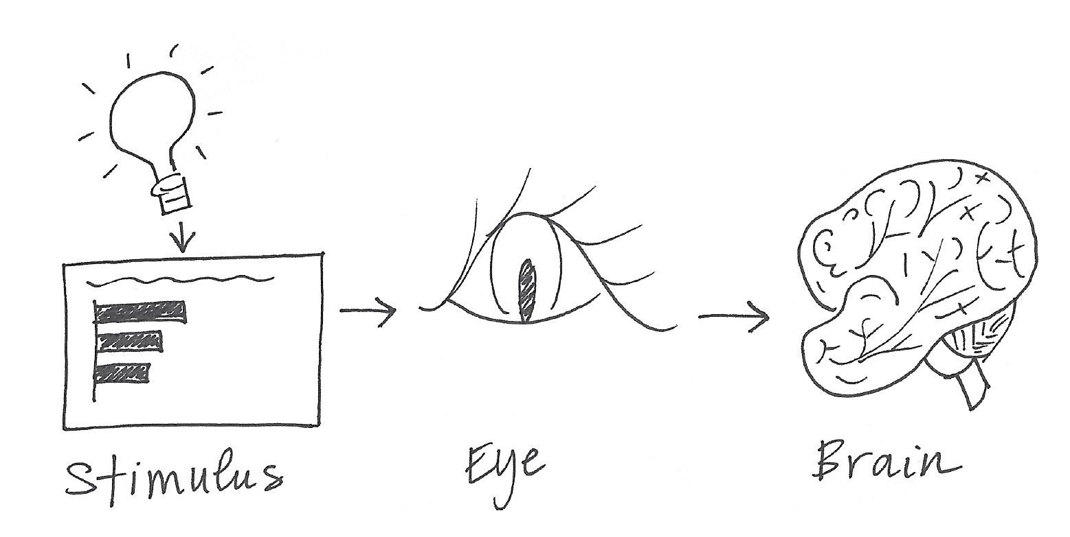
Short-term memory → Long-term memory
Source: Cole Nussbaumer Knaflic (2015, p.100)

Slide 19
Decoding → Understanding
Brainpower used for decoding
Brainpower left for
understanding
TOTAL BRAINPOWER AVAILABLE
Source: Adapted from Iliinsky and Steele (2011, p.24)

Slide 20
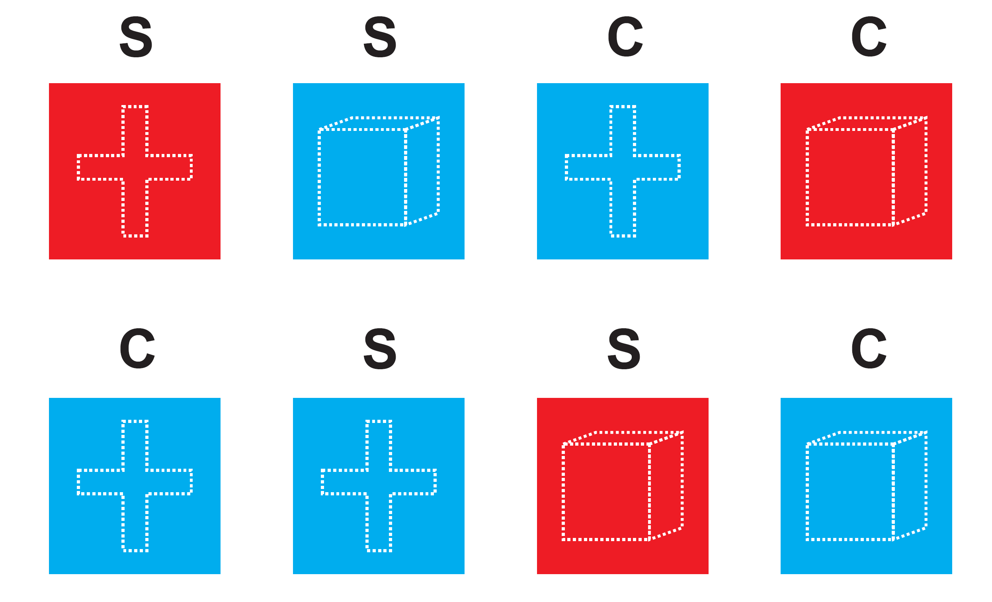
S = Shape C = Colour

Slide 21
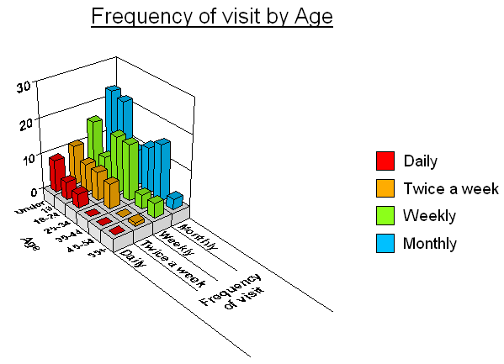
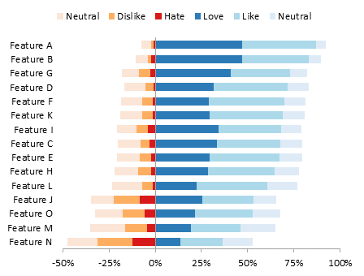

More Complex ≠ Better

Slide 22
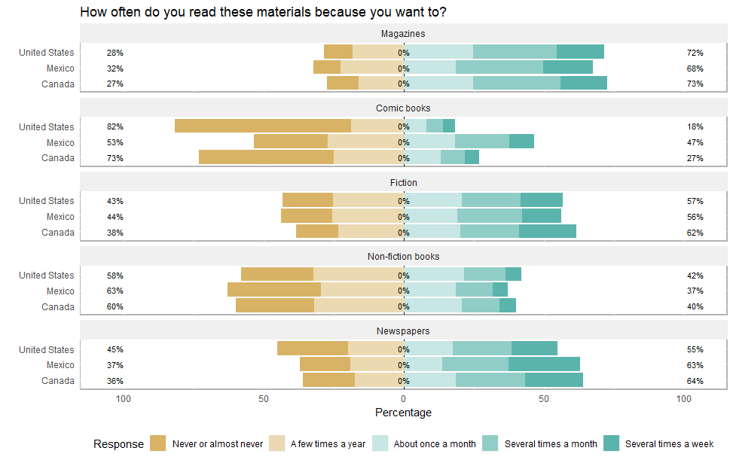
What is the takeaway message in this figure?
Source: PISA 2009

Slide 23
“Simplicity is the ultimate sophistication.”
-- Leonardo da Vinci

Slide 24
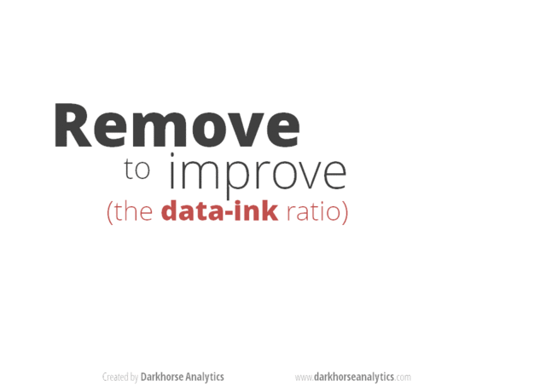
Source: https://www.darkhorseanalytics.com/blog/data-looks-better-naked

Slide 25
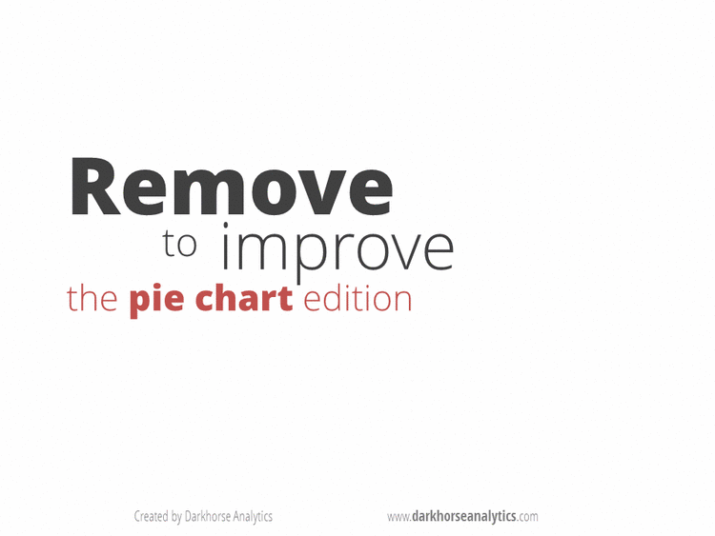
Source: https://www.darkhorseanalytics.com/blog/salvaging-the-pie

Slide 26
Ordering Values
Colour
Size

Slide 27
Ordering Values
Shape
Length

Slide 28
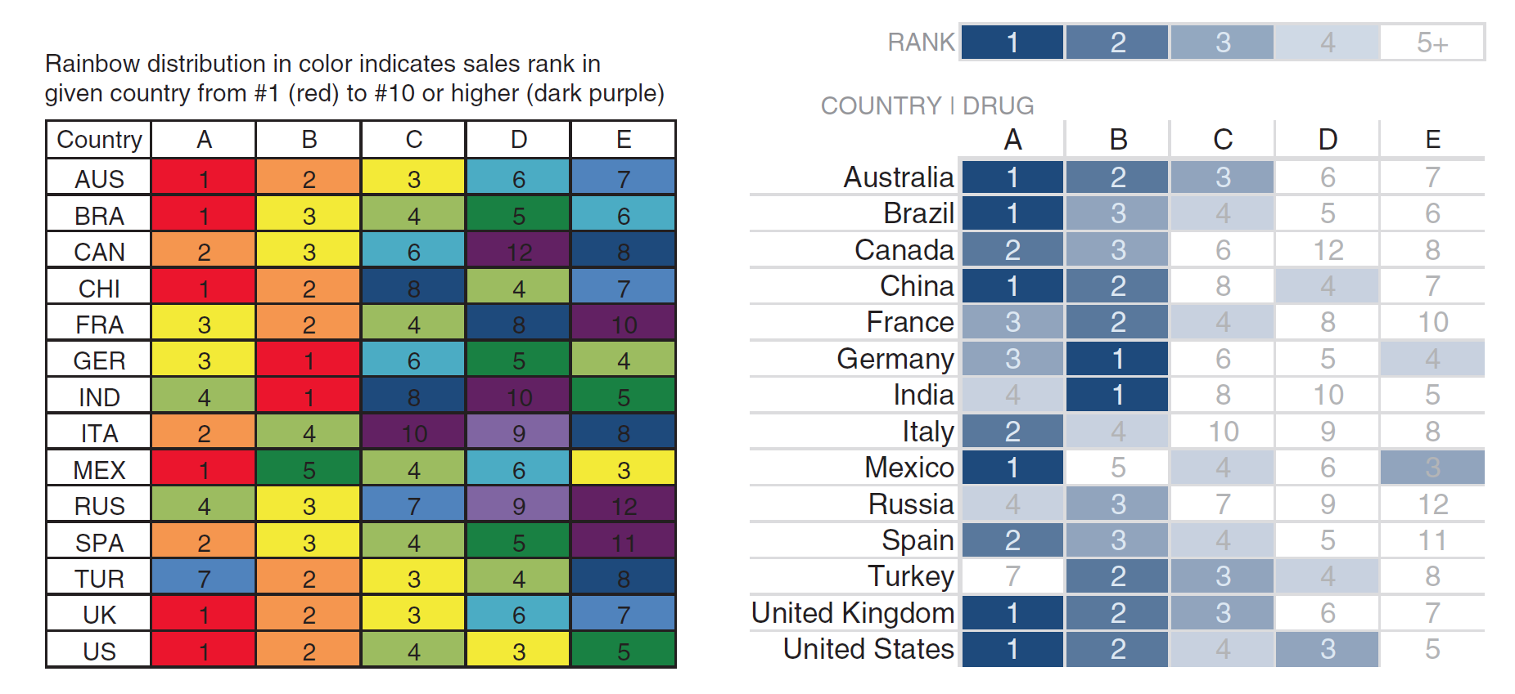
Ordering Values
Source: Cole Nussbaumer Knaflic (2015, p.119)

Slide 29
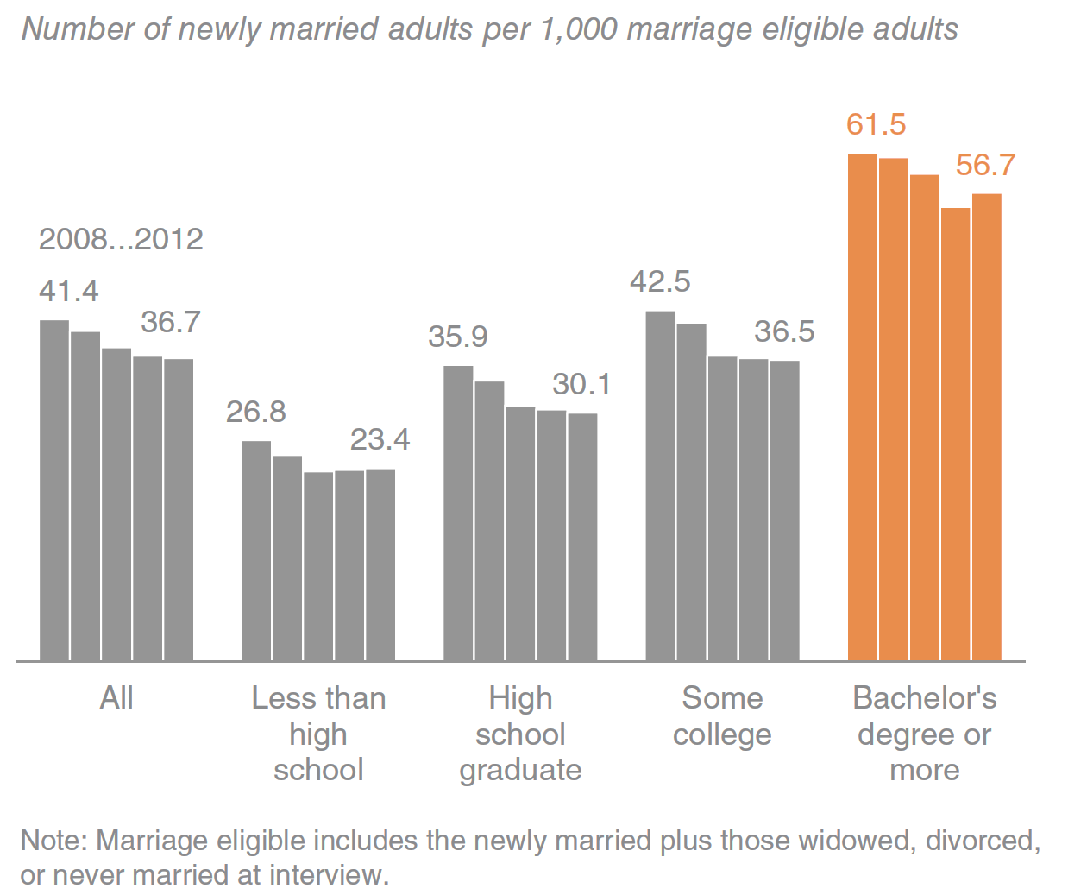
Ordering Values
Source: U.S. Census

Slide 30
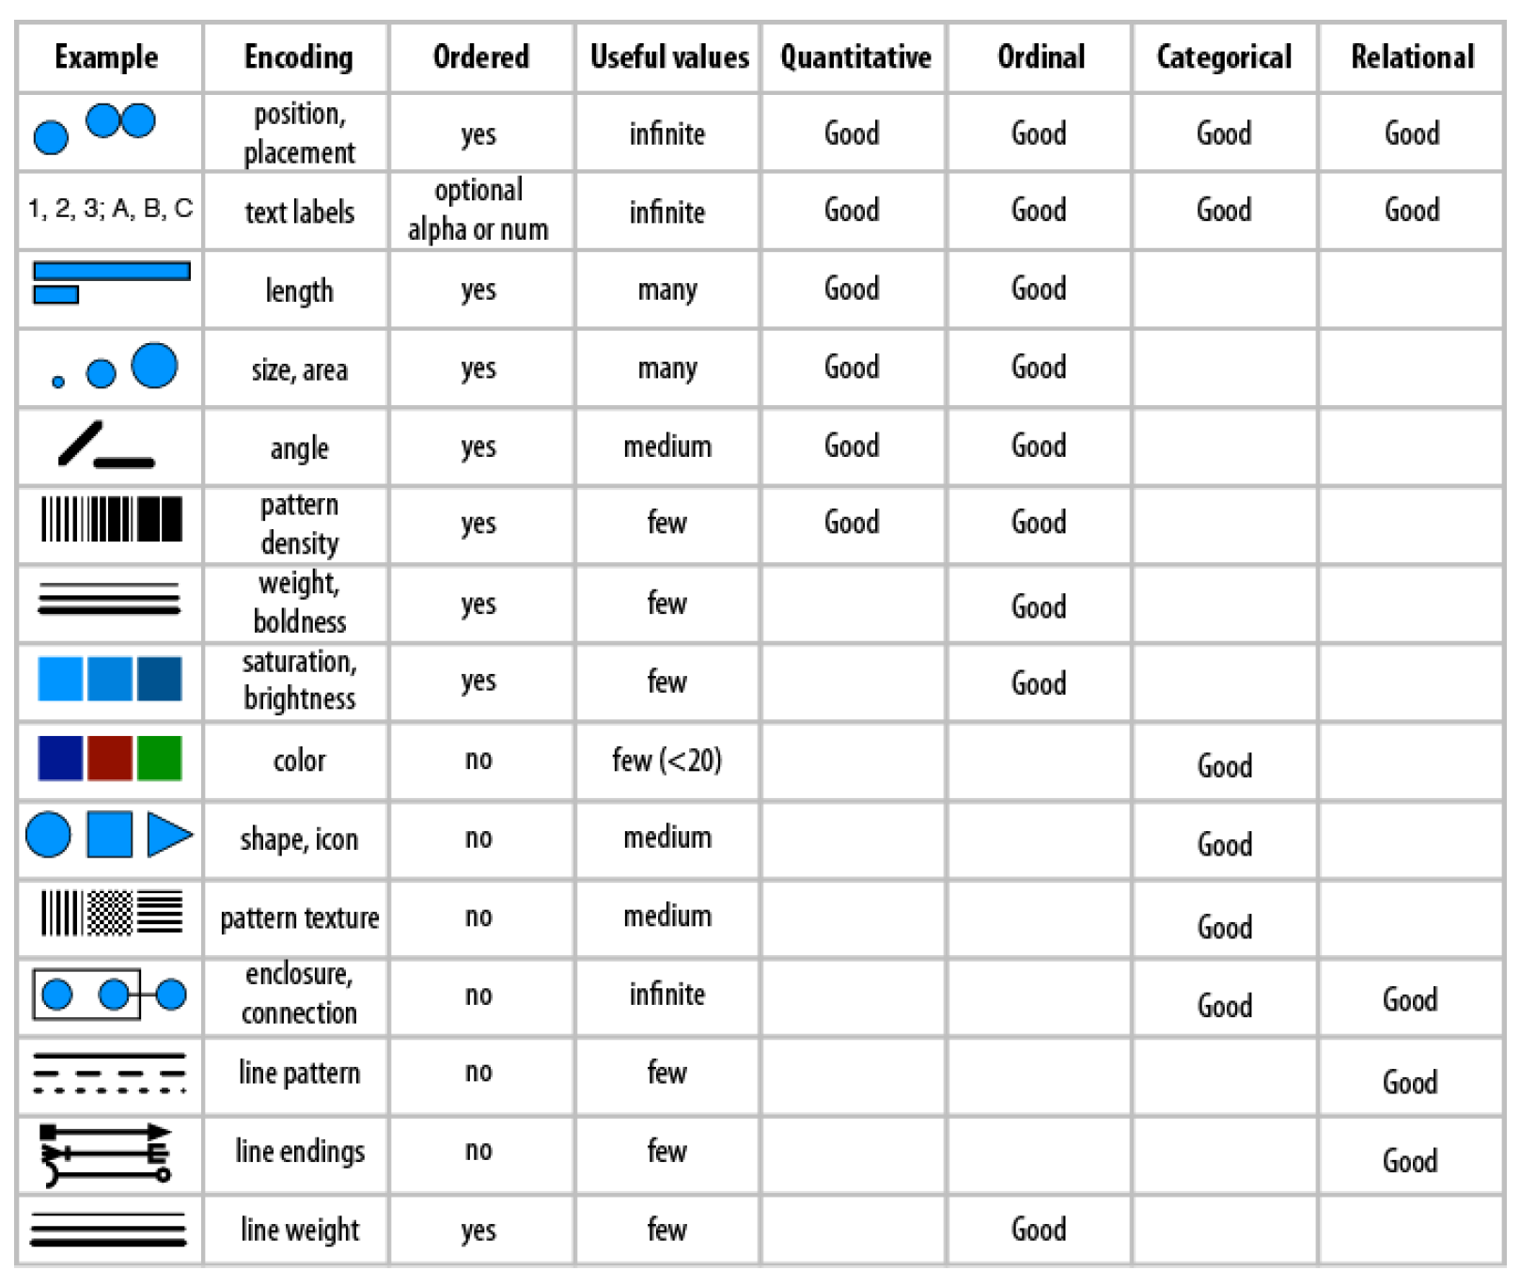

Slide 31
Ordering Values

Slide 32
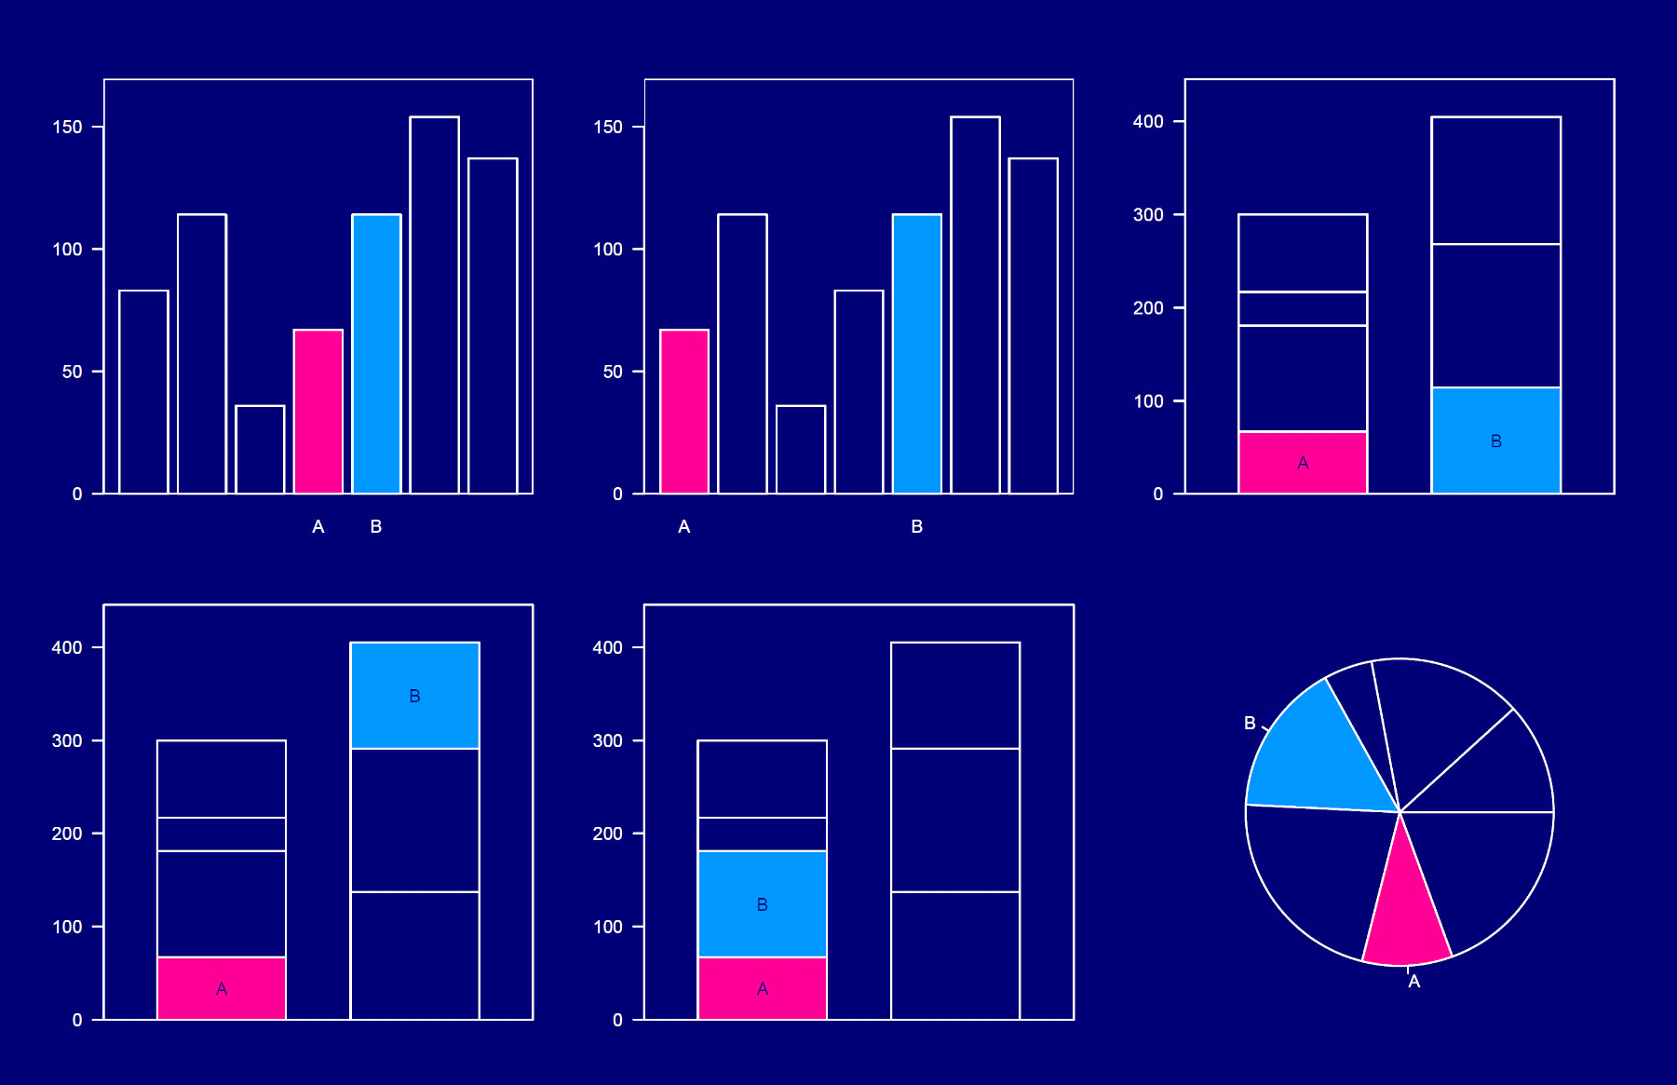

Which comparison is easier?
1
2

Slide 33
Which comparison is the easiest?
1
2
3

Slide 34
Which comparison is the easiest?
1
2
3
4
5
6

Slide 35
Decide the scale carefully

Slide 36
The success of your visualization is measured by your audience’s understanding.
They are not you...
Understand the context in which your audience is thinking.

Slide 37
Data Visualization Software

Slide 38





Software Options
https://www.microsoft.com
https://www.tableau.com
https://datastudio.google.com
https://plot.ly/
https://cran.r-project.org/

Slide 39
Software Options
Excel
Tableau
Google Data Studio
Plotly
R
 | Commercial | Commercial + Public | Commercial + Public | Commercial + Public | Open-source & Free
 | Easy | Moderate to High | Moderate to High | Moderate to High | High Difficulty
 | Moderate quality | High quality | High quality | High quality | High quality
 | Static | Static + Interactive | Interactive | Interactive | Static + Interactive

Slide 40
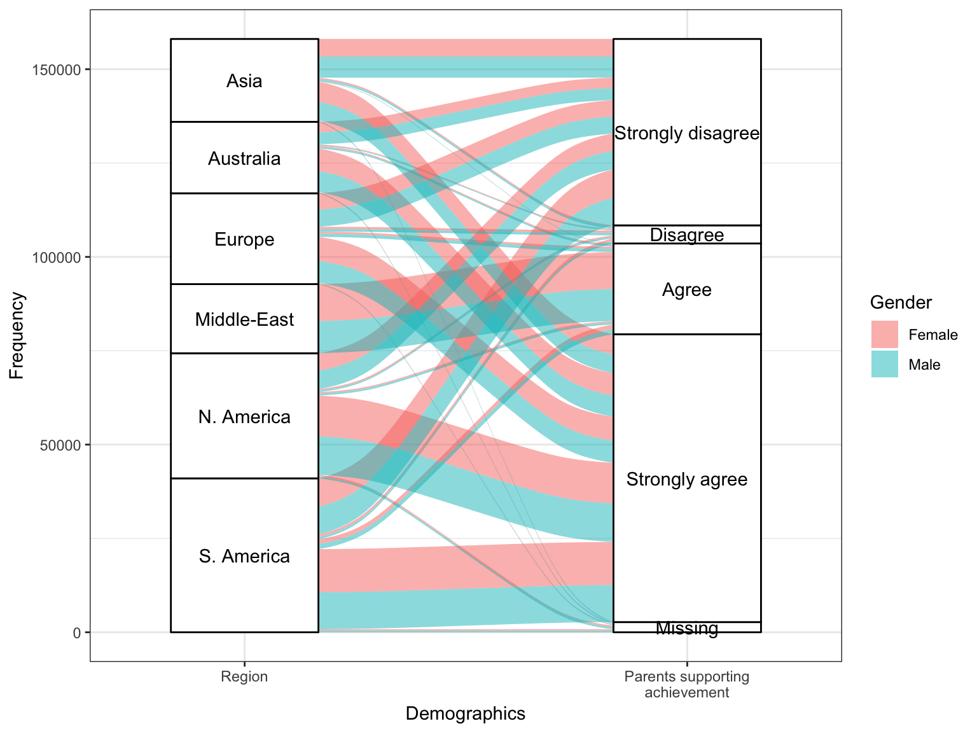
Alluvial Plot
My parents support my educational efforts and achievements.
Strongly disagree
Disagree
Agree
Strongly agree
Source: PISA 2015

Slide 41
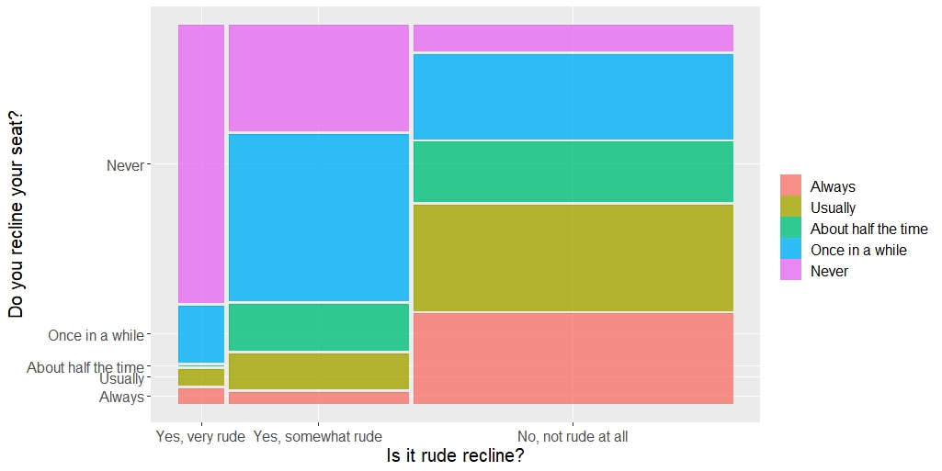
Mosaic Plot
Source: Flying Etiquette Survey - https://fivethirtyeight.com/features/airplane-etiquette-recline-seat/

Slide 42
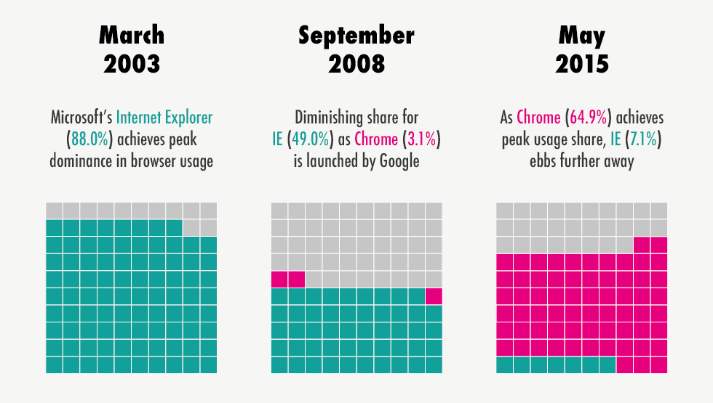
Waffle (Square Pie) Chart
Source: https://homepage.divms.uiowa.edu/~luke/classes/STAT4580/catone.html

Slide 43
Other Software Options
1
jamovi
https://www.jamovi.org/
Free (utilizing R in the background)
Compatible with Windows, Mac, and Linux
Good for both statistical analysis and data visualizations
Modrian
http://mondrian.theusrus.de/
Free and open source
Compatible with Windows, Mac, and Linux
Good for a variety of visualizations (from basic to complex plots)
2

Slide 44

Visualizing Survey Items

Slide 45
Checklist for Evaluating Items
Alignment
3
Construct validity
5
Check if the items are related to each other
Check if the items can define a single construct properly
Functionality
2
Check if response options of the items function properly
Discrimination
4
Check if the items discriminate low and high levels of the construct
Missingness
1
Check if the items suffer from extreme missingness

Slide 46

Example
http://www.oecd.org/pisa/
A large-scale, international assessment for 15-year-old students
Administered every 3 years
540,000 students from 72 countries participated in PISA 2015
Reading, science, and math assessments (plus additional subject areas)
Student, teacher, and school survey items to learn more about students

Slide 47
Example
Alberta students who participated in PISA 2015 (n = 2,133)
Data files are available at: https://github.com/okanbulut/dataviz
PISA_Alberta.xlsx
PISA_Alberta.csv
PISA_Alberta.sav
10 Likert-type survey items potentially measuring “attitudes towards teamwork”
Each question has the following response options:
1 = Strongly disagree 2 = Disagree 3 = Agree 4 = Strongly agree

Slide 48
First eight questions share the same statement:
“To what extent do you disagree or agree about yourself?”
I prefer working as part of a team to working alone.
I am a good listener.
I enjoy seeing my classmates be successful.
I take into account what others are interested in.
I find that teams make better decisions than individuals.
I enjoy considering different perspectives.
I find that teamwork raises my own efficiency.
I enjoy cooperating with peers.
The other two items are independent:
I make friends easily at school.
Other students seem to like me.

Slide 49
Microsoft Excel
Missingness
01
Make sure that missing values are labeled with a distinct value (e.g., 999).
Create a pivot table for each item (see this tutorial on how to create pivot tables in Excel)
Insert a bar graph to examine missingness visually (see the example file that I shared at https://github.com/okanbulut/dataviz.
Row Labels | Count of ST082Q01NA
1 | 186
2 | 477
3 | 1021
4 | 366
999 | 83
Grand Total | 2133

Slide 50
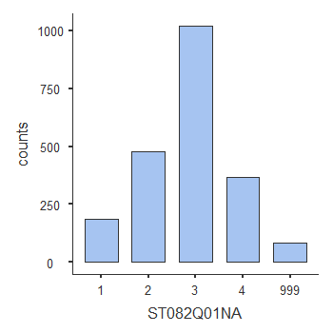
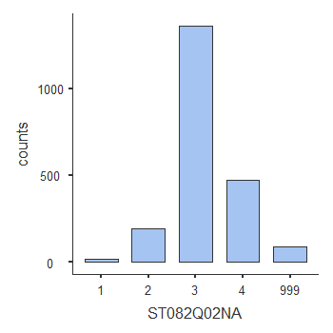
jamovi
Missingness
02
Make sure that missing values are labeled with a distinct value (e.g., 999).
Import the data into jamovi.
Exploration → Descriptives → Bar Plots (see my tutorial video HERE)

Slide 51
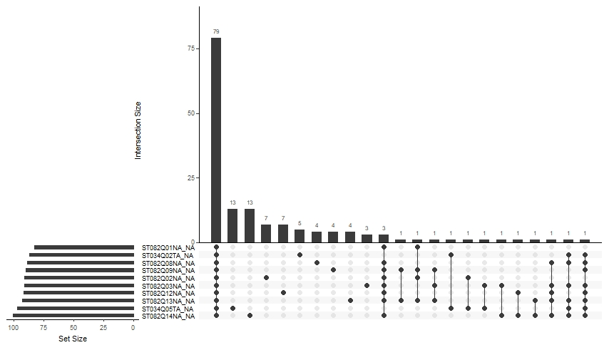
naniar package in R
Missingness
03
Check out this nice vignette on the naniar package.
install.packages("naniar")
library("naniar")
mydata <- read.csv("PISA_Alberta.csv", header = TRUE, na.strings = 999)
# Select only the survey items
gg_miss_upset(mydata[, 6:15], nsets = 10)
For the web application (without R coding):
https://gehlenborglab.shinyapps.io/upsetr/

Slide 52
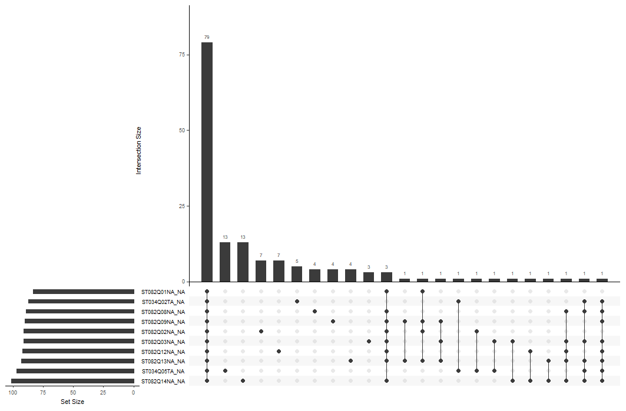
79 students skipped all of the items.
Most skipped item

Slide 53
Should we worry
about missingness?

Slide 54
Microsoft Excel
Functionality
Make sure that missing values are NOT labeled this time (i.e., replace 999 with null)
Create a new pivot table for each item (this time missing is NOT included) and calculate percentages based on counts.
Insert a bar graph to examine the percentages for each response option for a given item.
My threshold for an acceptable response rate is typically 5%. So, you can add a horizontal line at 5% as a threshold (see this nice tutorial on how to add such a line into Excel)
Which response option(s) are not functioning well?
I take into account what others are interested in.

Slide 55
I prefer working as part of a team to working alone.
I am a good listener.
I enjoy seeing my classmates be successful.
Other students seem to like me.

Slide 56
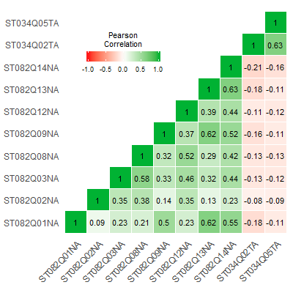
jamovi
Alignment
Make sure that missing values are NOT labeled with a distinct value (e.g., missing is null).
Import the data into jamovi.
Factor → Reliability Analysis → Correlation heatmap (see my tutorial video HERE)
Problematic items

Slide 57
jamovi + Microsoft Excel
Discrimination
Make sure that missing values are NOT labeled with a distinct value (e.g., missing is null).
Import the data into jamovi.
Factor → Reliability Analysis → Cronbach’s α & Item-rest correlation (see my tutorial video HERE)
Copy the output table and paste it into an Excel spreadsheet
I am a good listener.

Slide 58
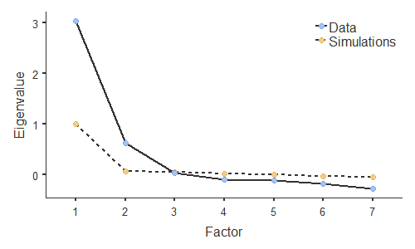
jamovi
Construct Validity
Make sure that missing values are NOT labeled with a distinct value (e.g., missing is null).
Import the data into jamovi.
Factor → Exploratory Factor Analysis → Scree plot (see my tutorial video HERE)

Slide 59




Some Resources…

Slide 60
Some Resources…
Navarro and Foxcroft - Learning Statistics with jamovi
Santiago Ortiz - 45 ways to communicate two quantities
Stephanie Evergreen - Data Visualization Checklist
Financial Times - Visualization Vocabulary
Darkhorse Analytics - Visualizing Distributions
Chez Voila - Glass Ceiling Visuals Remake
Eager Eyes - Understanding Pie Charts

Slide 61
Thank You
For questions and comments: bulut@ualberta.ca

